Slide 1

Task#08 - Extempore Activity
Extempore: IT in Automobile, Metro Rail, and Avionics
T.BHAVANI-23781 A05F0
U.G.WAJIHA-23781A05F1
V.LAHARI-23781A05F5
V.YESHWITHA-23781 A05F6
V.P.LALITHA-23781A05F7
V.SIREESHA-23781A05F8
V.SUPRAJA-23781A05F9

Slide 2
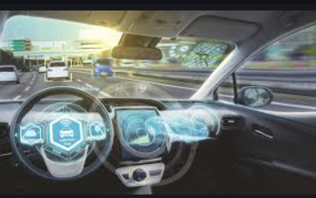
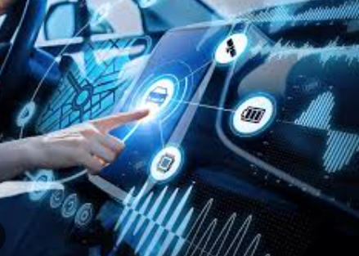
IT in Automobile
Introduction:
The automotive industry has undergone significant transformations with the integration of IT.
Key Applications:
Navigation and Infotainment Systems - Advanced Driver-Assistance Systems (ADAS) - Vehicle-to-Everything (V2X) Communication - Autonomous Vehicles
Benefits:
Enhanced safety, improved driver experience, increased efficiency

Slide 3
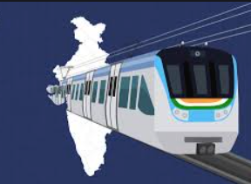
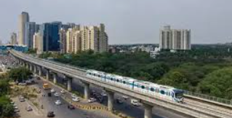
IT in Metro Rail
Introduction:
IT plays a vital role in the efficient operation of metro rail systems.
Key Applications:
- Automated Fare Collection Systems - Train Control and Signaling Systems - Passenger Information Systems - Smart Card and Mobile Payment Systems
Benefits:
Improved passenger experience, increased efficiency, enhanced safety

Slide 4
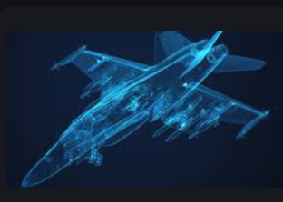
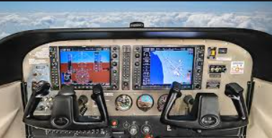
IT in Avionics
Introduction:
IT is crucial in the aviation industry, enabling safe and efficient flight operations.
Key Applications:
- Flight Management Systems - Air Traffic Control Systems - Navigation and Communication Systems - Aircraft Health Monitoring Systems
Benefits:
Enhanced safety, improved efficiency, reduced costs

Slide 5


Future Outlook
Emerging Trends:
Artificial Intelligence (AI) and Machine Learning (ML) - Internet of Things (IoT) - Blockchain- Future
Applications:
Autonomous vehicles and drones - Smart airports and metro stations - Predictive maintenance and quality control

Slide 6
Conclusion
- IT has transformed the automobile, metro rail, and avionics industries
Thank you

